Slide 1

Software Application Development
- Tools for Product Activities-
GitHub
2022-2
Young J. RHO
Notes:
1
Thomas Friedman’s work
Additional resources and websites:
http://www.thomaslfriedman.com/bookshelf/the-world-is-flat
“The Lexus and the Olive Tree,” http://www.thomaslfriedman.com/bookshelf/the-lexus-and-the-olive-tree; finding a proper balance in business with this new globalization/online business environment

Slide 2
Possible for My Project
Objects Activities | Product | Process | People
Management
Measurement
Development
Configuration M
(Product M)
Project M
Team M
Roles
Git for version control
Excel for scheduling
Quality
Productivity
Ability
M-V-C
Data size(Model)
UI size(View)
Program size(Control)
Documentation
Teamwork
Development Tools
SW Process
Training / Education
Target environment
Client & server
Development env.
Agile method
Required skills

Slide 3
GitHub
Topical Contents
GitHub SignUp
Tools
Creation and Deletion of repository in the GitHub
Tools
GitHub Desktop
Roles, skills & communications

Slide 4

Tools for Product Management
Version control and coworking
GitHub

Slide 5

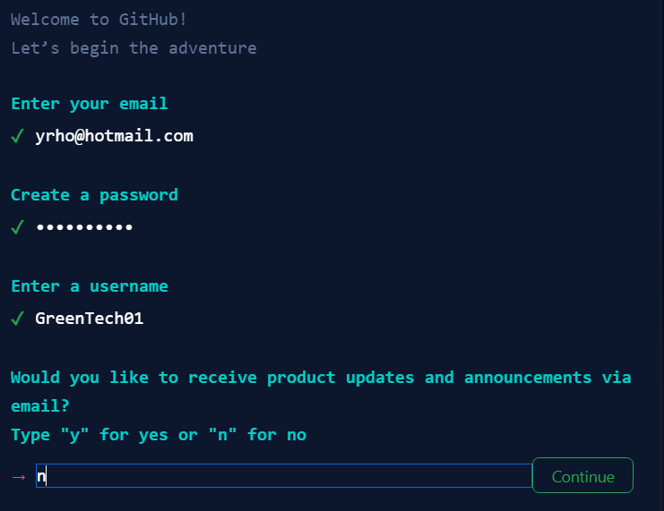
GitHub
Sign up
Your email
Password
User name
Authentication through the registered email

Slide 6
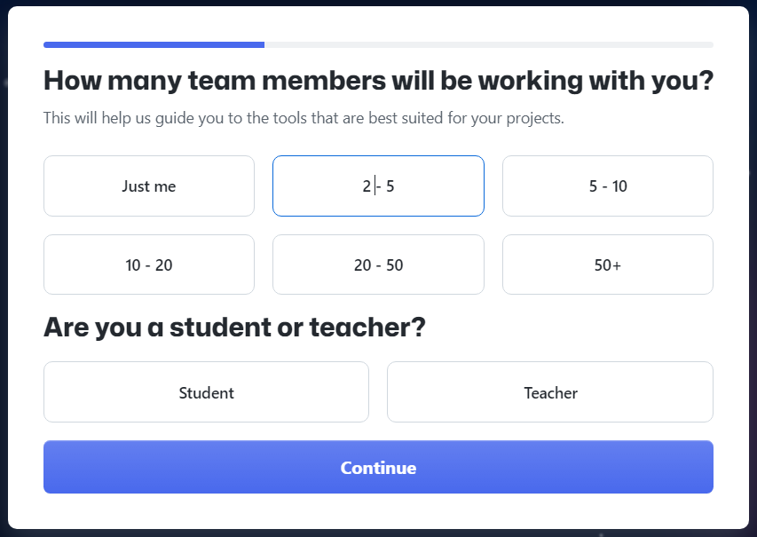
GitHub
Cont’ to sign up

Slide 7
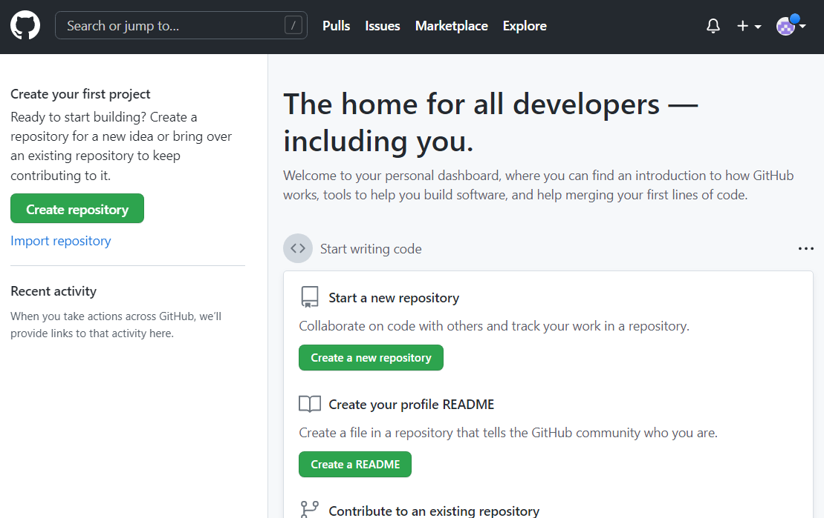
GitHub
Create a new repository
In the GitHub under your account

Slide 8
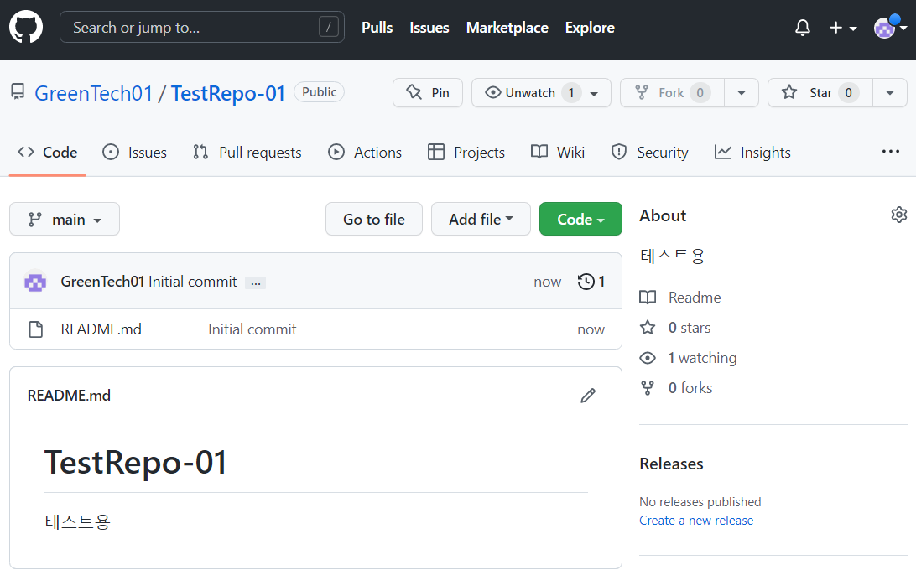
GitHub
Create a new repository
In the GitHub under your account

Slide 9
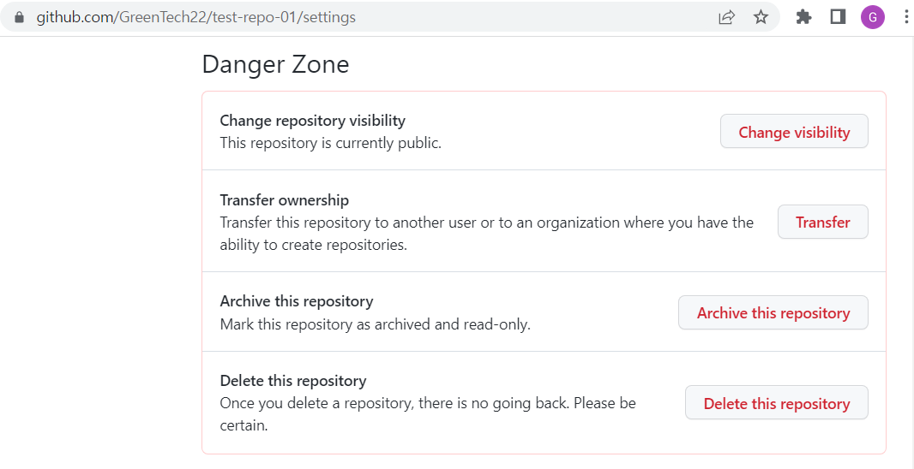
GitHub
Delete repository
Select the target repository, then
Settings and Danger Zone

Slide 10
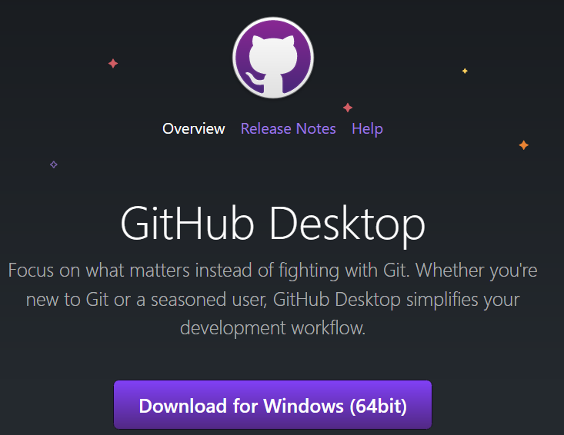
GitHub
Installation of GitHub Desktop
Download if not installed already

Slide 11
GitHub
GitHub Desktop
2 ways to create a repository
Cloning
Create a repository in the GitHub, and then clone it on the local drive with the Desktop
Publishing
Create a local repository with the Desktop, and then publish it to the GitHub

Slide 12
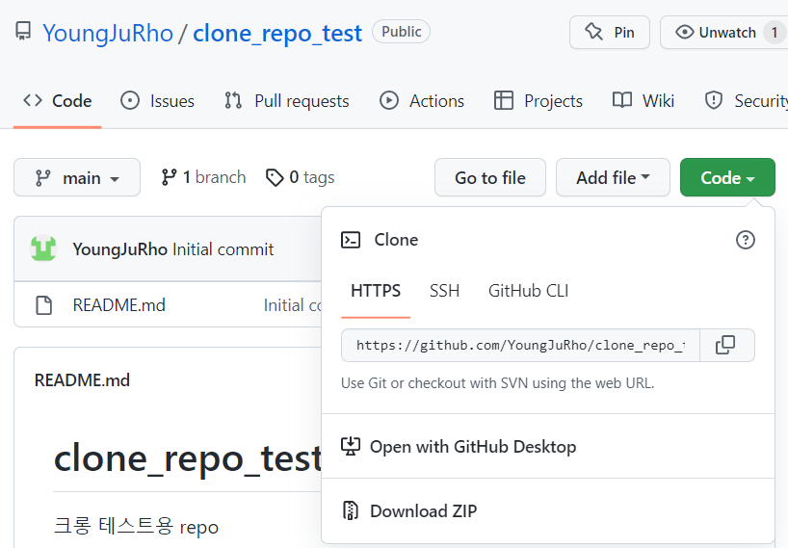
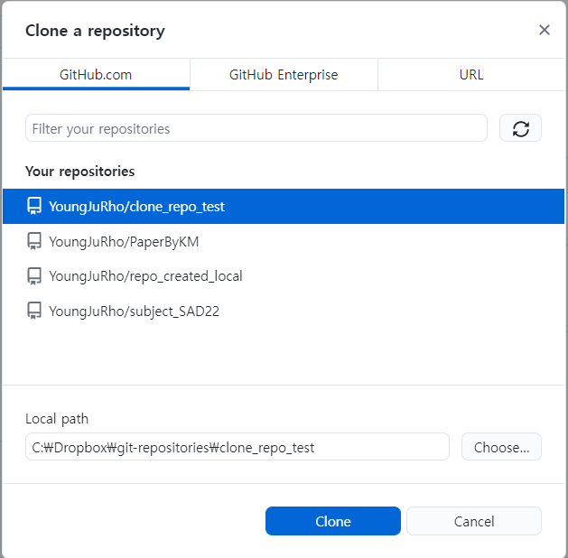
GitHub
GitHub Desktop
Create a repository and clone it to the local hard drive
GitHub.com
GitHub Desktop

Slide 13
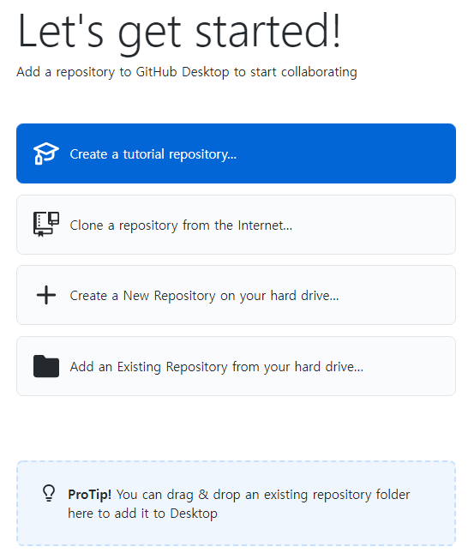
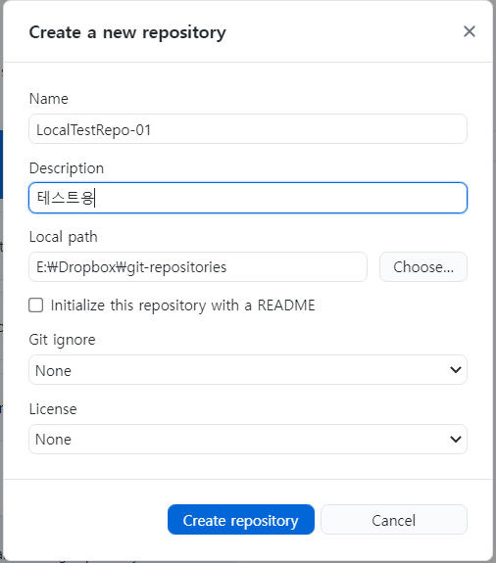
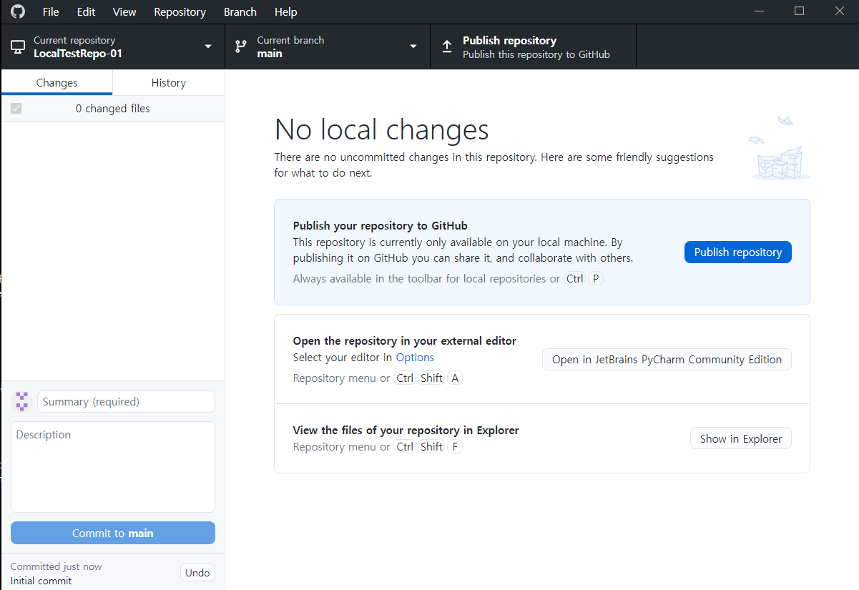
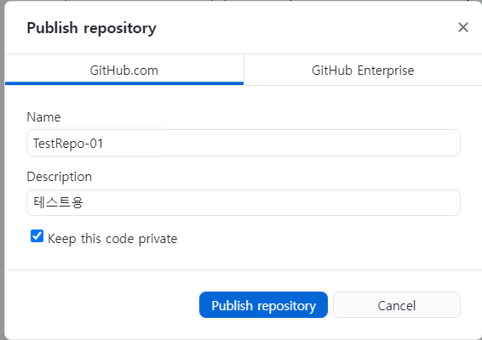
GitHub
GitHub Desktop
Create a local repository and publish it to the GitHub

Slide 14
Q & A

